Slide 1
Federal Sponsor (or Federal Sponsors as Prime)
Enter the FOA number as printed on the solicitation
Enter the title as printed on the solicitation
If there is an acronym that is commonly used add in parenthesis after the full title

Slide 2
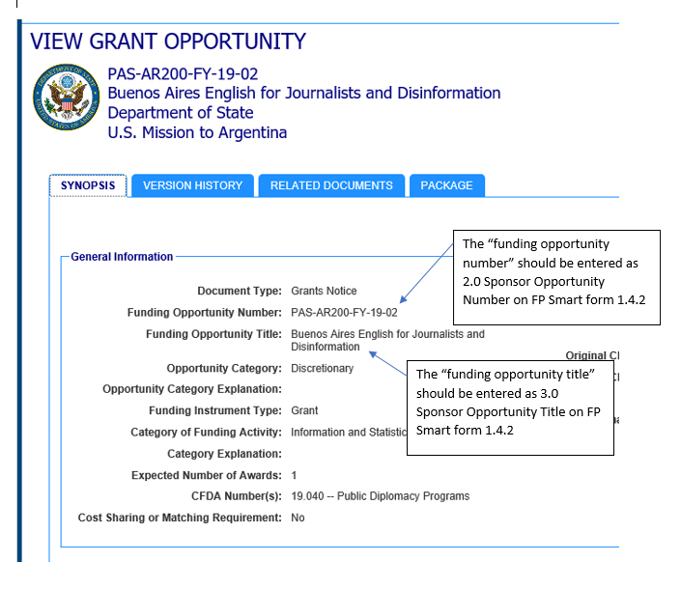
Federal Example #1
Funding Opportunity Announcement
ERA Data Entry

Slide 3
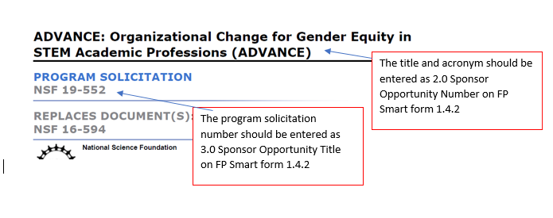
Federal Example #2
Funding Opportunity Announcement
ERA Data Entry

Slide 4
Non-Federal Sponsors
For Non-Federal Sponsors without a solicitation number
Enter the funding opportunity name or program title as both the FOA number and title
If there is an acronym that is commonly used add in parenthesis after the full title

Slide 5
Non-Federal Example #1
Funding Opportunity Announcement
The title should be entered as 2.0 Sponsor Opportunity Number & 3.0 Sponsor Opportunity Title on FP Smart form 1.4.2
ERA Data Entry

Slide 6
Non-Federal Example #2
Funding Opportunity Announcement
The title should be entered as 2.0 Sponsor Opportunity Number & 3.0 Sponsor Opportunity Title on FP Smart form 1.4.2
ERA Data Entry

Slide 7
“No FOA”
When to use No FOA
No FOA should only be used when there is truly no solicitation

Slide 8
Questions? Please contact your assigned Proposal GCO or ERA@asu.edu

