Slide 1
Conferences and Meetings
Kim Fields and Chris Sittler

Slide 2
Introduction
Objectives:
Participants will gain an understanding of allowable costs for conferences and meetings
Participants will be introduced to categorizing conference costs within a proposal
Participants will learn about program income, inclusion requirements in a proposal and accounting methodologies
Conference and Meeting grants can be difficult to manage—Federal oversight of the nuanced budget categories requires a high-level of detail to ensure a successful proposal. This session is intended to examine the expense categories commonly associated with Conference and Meeting grants, from proposal preparation to post-award management.
We will focus on federal sponsor rather than non-federal, as non-federal sponsors place fewer restrictions on allowable expenses.

Slide 3
Conferences and Meetings are a bit different right now… We will be presenting information based on a non-pandemic environment. Please note that due to COVID-19, many additional guidelines are in place for the various federal sponsors.
Relocated to Zoom

Slide 4
What is a Conference/Meeting Grant?
Uniform Guidance: § 200.432 Conferences:
A conference is defined as a meeting, retreat, seminar, symposium, workshop or event whose primary purpose is the dissemination of technical information beyond the non-Federal entity and is necessary and reasonable for successful performance under the Federal award. Allowable conference costs paid by the non-Federal entity as a sponsor or host of the conference may include rental of facilities, speakers' fees, costs of meals and refreshments, local transportation, and other items incidental to such conferences unless further restricted by the terms and conditions of the Federal award. As needed, the costs of identifying, but not providing, locally available dependent-care resources are allowable. Conference hosts/sponsors must exercise discretion and judgment in ensuring that conference costs are appropriate, necessary and managed in a manner that minimizes costs to the Federal award. The Federal awarding agency may authorize exceptions where appropriate for programs including Indian tribes, children, and the elderly.

Slide 5
Pre-Award

Slide 6
Step 1: Carefully review the Program Announcement
The Program Announcement (often called RFP, RFA, FAO) will typically list the specific requirements for submission, including what can and cannot be included in the grant. It is always a good idea to carefully review this before preparing your proposal.
However, in some cases, the program announcement might not provide a lot of information outside of what to address in the project narrative—for example, we will look at NSF 21-541.

Slide 7
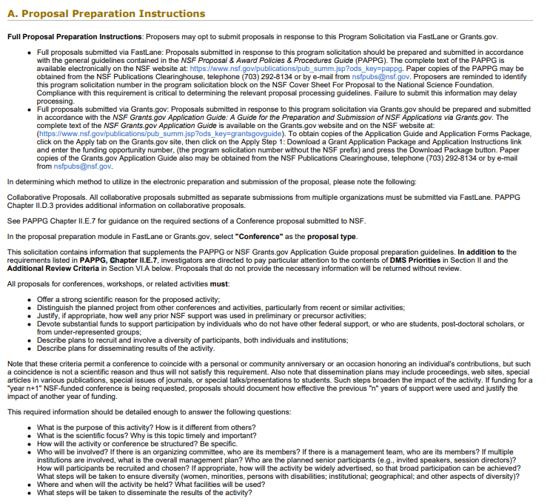
Example: NSF 21-541
Here we have the Proposal Preparation Instructions—this section includes a lot of what the sponsor is looking for in the descriptive sections of the proposal, such as the project narrative… but what about budget information?

Slide 8
Example: NSF 21-541
Obviously, not a lot of information is being provided here.
It is also important to have sponsor-specific guides available to fully understand what to include in the proposal, especially when it comes to budgeting.

Slide 9
Sponsor Guidelines:
These are essential tools for proposal development, often including more nuanced information regarding that should be included in the application, and what is allowable per the specific sponsor.
NSF: PAPPG
NIH: GPS and NIH Application Guide
USDA/NIFA: NIFA Grants.gov Application Guide
FDA

Slide 10
Still have questions?
Solicitations and Guidelines can be difficult to navigate, and even more difficult to understand. Be sure to reach out to your internal and external support systems if you are unsure about something:
Department Research Administrator/Business Official
Sponsored Projects/Centralized Office for Sponsored Research
Program Official, or PO, is the sponsor point-of-contact, typically listed in the solicitation and program website.

Slide 11
Step 2: Plan Accordingly
Contracts/awards can take time—make sure to plan time appropriately. NSF indicates that a proposal should be submitted at least a year in advanced of the scheduled date.
With Conferences/Meetings, there are additional things that should be taken into consideration outside of the mandated proposal due dates and start date:
Announcement of the Conference/Meeting
Registration Periods
Travel
Food Services
Optics of Location
It is important that you work with your business offices and centralized sponsored research office to ensure institutional guidelines are followed when planning. Be sure you are utilizing appropriate departments/requirements when planning these components of the project.

Slide 12
Uniform Guidance: Suggested Guidance for Conference Planning
Uniform Guidance provides extensive guidelines when it comes to planning for your conference/meeting project. Be sure to consult 41 CFR Appendix E to Chapter 301 – Suggested Guidance for Conference Planning.
Within these guidelines, specifics on the following are provided to get you started:
Planning Committee – operational group significantly contributing to the success/needs for the conference.
Milestone Schedule – listing of project milestones to include each major step.
Specification Sheet – identify essential elements and determine costs.
Budgeting – decide how the conference expenses will be paid, and through what sources of funding.
This comprehensive guide also touches on topics of location, facilities, food & refreshments, announcements/invitations, and much more… Be sure to utilize this guide!

Slide 13
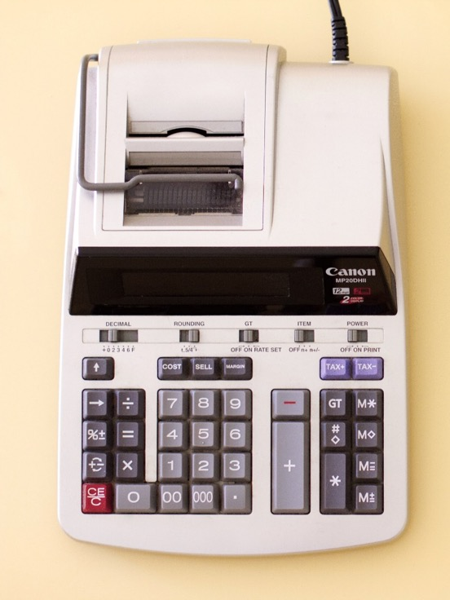
Step 3: Budgeting
Federal sponsors have very specific allowances when it comes to budgeting for Conferences/Meetings. In this section we will cover some of the basics of allowable vs. unallowable costs.

Slide 14
Alcohol
Uniform Guidance is clear on the inclusion of Alcoholic beverages: federal funds cannot be used to purchase alcohol.
§ 200.423 Alcoholic beverages.
Costs of alcoholic beverages are unallowable.

Slide 15
Entertainment
Similar to Alcohol, Entertainment is generally not allowed. However, Uniform Guidance does provide more instruction on when costs related to entertainment may be allowable:
§ 200.438 Entertainment costs.
Costs of entertainment, including amusement, diversion, and social activities and any associated costs are unallowable, except where specific costs that might otherwise be considered entertainment have a programmatic purpose and are authorized either in the approved budget for the Federal award or with prior written approval of the Federal awarding agency.

Slide 16
Lobbying
The use of federal funds for lobbying is never an allowable expense.
§ 200.450 Lobbying.
(a) The cost of certain influencing activities associated with obtaining grants, contracts, or cooperative agreements, or loans is an unallowable cost …
(b) Executive lobbying costs. Costs incurred in attempting to improperly influence either directly or indirectly, an employee or officer of the executive branch of the Federal Government to give consideration or to act regarding a Federal award or a regulatory matter are unallowable…

Slide 17
Room Rental and A/V Equipment
Room/Meeting Space and A/V Equipment rental is an allowable, and necessary cost associated with Conference and Meeting Grants.
§ 200.465 Rental costs of real property and equipment.
(a) Subject to the limitations described in paragraphs (b) through (d) of this section, rental costs are allowable to the extent that the rates are reasonable in light of such factors as: rental costs of comparable property, if any; market conditions in the area; alternatives available; and the type, life expectancy, condition, and value of the property leased. Rental arrangements should be reviewed periodically to determine if circumstances have changed and other options are available.
Take into account, however, that these costs need to be reasonable, as compared to market value/conditions of the area.

Slide 18
Speaker Fees
As outlined in § 200.432 Conferences, speaker fees are an allowable expense.
Remember, speakers are not participants, and in general, should not be budgeted as participant support. NSF provides further guidance on this distinction:
if the primary purpose of the individual’s attendance at the conference is learning and receiving training as a participant, then the costs may be included under participant support. If the primary purpose is to speak or assist with management of the conference, then such costs should be budgeted in appropriate categories other than participant support.
Be sure to check your institutional policy regarding payment mechanisms for speakers.

Slide 19
Employee payroll/travel expenses/per diem
Budgeting personnel, travel, and per diem costs for employees of the receiving institute is an essential expense for conference grants, and generally allowable.
Be sure to review sponsor-specific guidelines for an understanding on the expectations regarding personnel effort.
Remember: Planning is essential for budgeting—given location-specific travel expenses, it is important to plan certain aspects of the Conference prior to submission to ensure expenses are reasonable and realistic.

Slide 20
Participant Support Costs
Participant Support Costs are generally allowable on Conference and Meeting Grants, however, these costs are typically heavily scrutinized by Federal sponsors, and should be budgeted carefully. Defined in § 200.1 - Definitions as:
Participant support costs means direct costs for items such as stipends or subsistence allowances, travel allowances, and registration fees paid to or on behalf of participants or trainees (but not employees) in connection with conferences, or training projects.

Slide 21
Participant Support Costs Direct costs for items such as stipends or subsistence allowances, travel allowances, and registration fees paid to or on behalf of participants or trainees (but not employees) in connection with conferences. Such allowances must be reasonable, in conformance with the policy of the proposing organization and limited to the days of attendance at the conference plus the actual travel time required to reach the conference location. Where meals or lodgings are furnished without charge or at a nominal cost (e.g., as part of the registration fee), the per diem or subsistence allowance should be correspondingly reduced. Although local participants may participate in conference meals and coffee breaks, funds may not be proposed to pay per diem or similar expenses for local participants in the conference. Not Participant Support Costs Speakers and trainers generally are not considered participants. However, if the primary purpose of the individual’s attendance at the conference is learning and receiving training as a participant, then the costs may be included under participant support. If the primary purpose is to speak or assist with management of the conference, then such costs should be budgeted in appropriate categories other than participant support. Venue rental fees, catering costs, supplies, etc. that will be secured through a service agreement/contract Employees of the university hosting the conference

Slide 22
Food – check with specific sponsor regulations
?
Food-related expenses associated with a conference are allowable when:
The event at which the meal expenses are incurred meets definition of a “conference”
are an integral and necessary part of the conference (e.g., working meals where business is transacted)
The expenses are paid by the university as the sponsor or host of the event
Note: NSF does not allow the use of federal funds for meal/coffee breaks for intramural meetings (labs, departments, centers).

Slide 23
Dependent Care – check with sponsor regulations
?
As needed, the costs of identifying, but not providing, locally available dependent care resources may be included.

Slide 24
Checking the FAQs—what do you think?
Is it allowable for a person whose travel costs are being paid with Federal grant funds to attend a conference in Washington, DC, and lobby members of Congress while in town?
To the extent that a portion of time at a conference is spent on lobbying activities, costs associated with the lobbying, including transportation to and from Washington, DC, lodging, and per diem, may not be charged to the Federal grant. For example, if a meeting or conference lasts for two days and a visit to lobby a member of Congress requires an additional day of travel, 1/3 of all costs involved in attending the meeting or conference, including travel to and from Washington, DC, may not be charged to the grant.

Slide 25
Checking the FAQs—what do you think?
Are costs such as room rental fees, catering, supplies, etc. related to an NSF-sponsored conference considered participant support costs?
No, the participant support cost line in the NSF budget should not be used for such costs.

Slide 26
Program Income at the Pre-award Stage:
Program Income is typical for Conference and Meeting Grants—typically, this comes in the form of registration fees. Per Uniform Guidance § 200.307 Program Income:
Non-Federal entities are encouraged to earn income to defray program costs where appropriate.
At the proposal stage, it is important to understand how to record expected Program Income when submitting a Proposal.
Note that, although the actual amount of income cannot be truly known, you should estimate the expected amount of program income when submitting your proposal. Consider registration fee amounts and the number of expected participants when developing your budget.

Slide 27
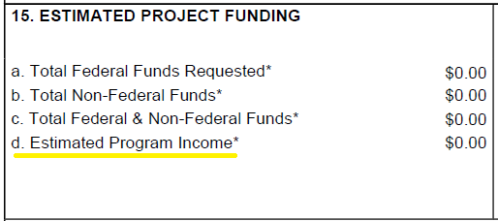
For NIH and NIFA Grants, Program Income is recorded in two places: The SF424 cover page, field 15.d. is reserved for the “Estimated Program Income.” Additionally, the PHS 398 Cover Page Supplement has a field for Program Income, #2. Note, in the Cover Page Supplement, you are expected to identify the Budget Period, Anticipated Amount ($), and Sources of income.

Slide 28
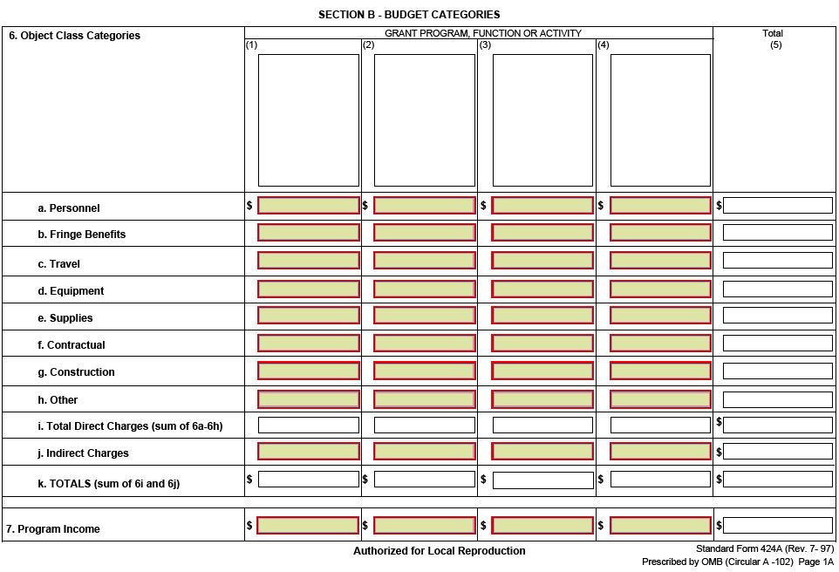
Other Federal Sponsors may require an SF-424A. This form also has a location for program income, located at the bottom of Section B. Be sure to include the expected program income amount here, and that it is associated with the correct grant program function or activity.

Slide 29
Post-award Congratulations! You’re having a conference!

Slide 30
Step 1: Carefully review the award terms and conditions
Review the award document, the FOA, the sponsor’s award management guide, and the awarded budget.
Look for any requirements that are specific to the award, for what kind of reports have to be submitted (programmatic and financial), and reporting deadlines before making conference arrangements.

Slide 31
Example: NIH Scientific Conferences (R13 and U13)
NIH expects conference grant recipients to provide attendees an environment free from discrimination and harassment, sexual or otherwise.

Slide 32
Be sure you know whether you have a grant, cooperative agreement, or contract because sponsors can have different requirements for each of them.

Slide 33
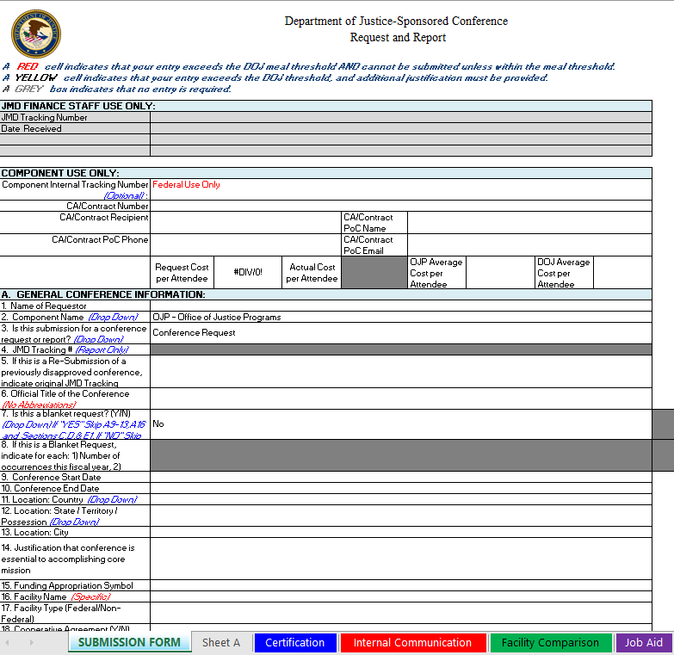
Example: Department of Justice
The Department of Justice requires prior written approval for conferences funded by cooperative agreements and contracts but not for grants and no-cost videoconferences or webinars. An approved award budget for a cooperative agreement or contract is not prior approval.

Slide 34
Step 2: Make purchases, contract for goods and services, monitor expenses
Review expenses as they’re incurred to be sure expenditures are allowable under the terms and conditions of the award and are within the period of performance.

Slide 35
Look before you leap!
Allowable costs with caveats to watch out for:
Conference services
Consultant services
Equipment rental
Meals
Coffee breaks
Publication costs
Speaker fees
Supplies
Travel
Conference venues

Slide 36
Step 3: Manage program income
Uniform Guidance: §200.80 Program income
Program income is gross income generated by a funded activity. This may happen for a conference if registration fees to attend are charged.
Pro tips for managing program income:
Spend program income before spending grant funds.
If a cost is allowable under the program award, then it is allowable to use program income for that cost.

Slide 37
Additive Program Income, $20K
Additive:
Program Income funds are added to award funds, increasing the amount available to accomplish the objectives.
In this instance, the sponsor commits $100K, and $20K of Program Income adds to this amount, giving the PI authority to spend a total of $120K.
Committed by Sponsor, $100K

Slide 38
Deductive:
Total funds available remain the same and funds generated are deducted from the financial commitment of the sponsor.
In this instance, the award amount is $100K, and $20K of Program Income is reduced from the sponsor’s portion, giving the PI authority to spend a total of $100K, and reducing sponsor commitment to $80K.
Deductive Program Income, $20K
Committed by Sponsor, $80K

Slide 39
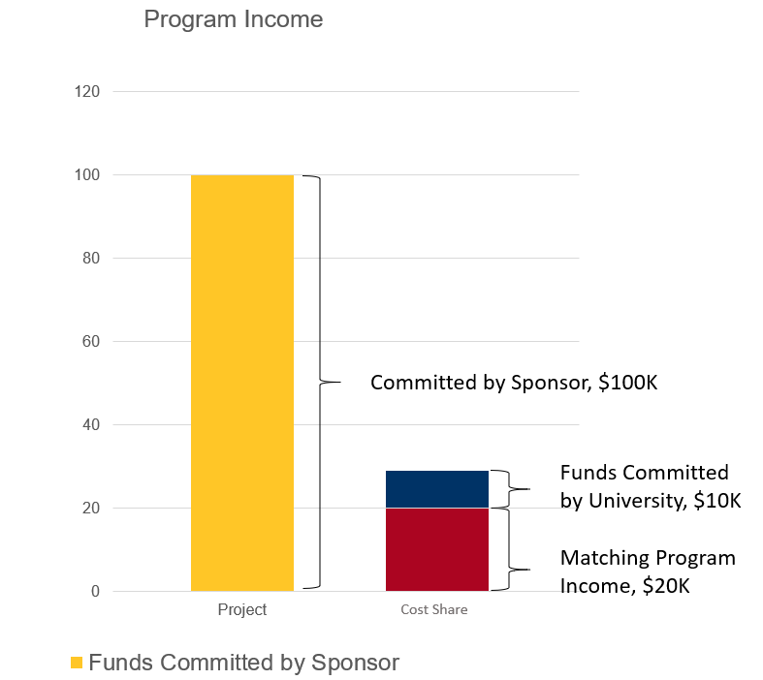
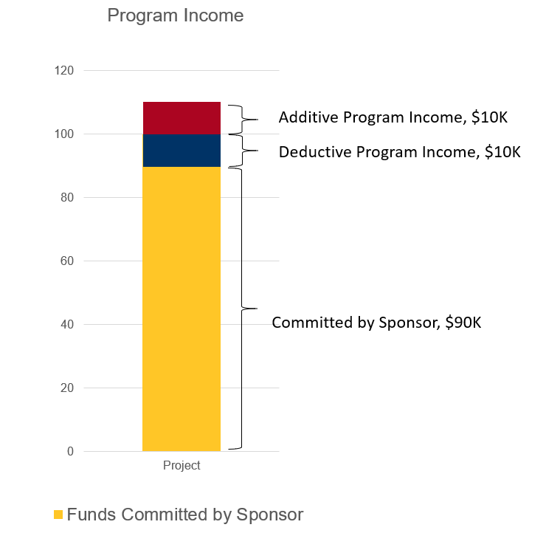
Matching:
Program Income funds are used to finance the non-sponsor share (mandatory or committed cost share).
Add/Deduct:
A portion of Program Income, specified by the sponsor, is added to award funds increasing the amount available, while the remaining Program Income is deducted from the sponsor’s financial commitment.

Slide 40
Step 4: Documentation and recordkeeping
Keep full documented justification for expenses to demonstrate how they are necessary to meet the goals and objectives of the award.
Documentation shows evidence of compliance with funder requirements in the event of an audit.

Slide 41
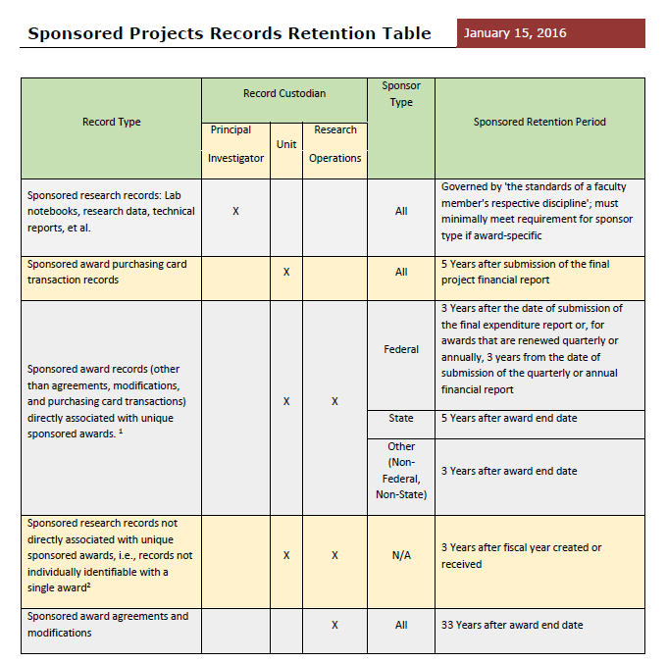
Keep all records, paper and/or electronic, for as long as required by the sponsor and institution.

Slide 42
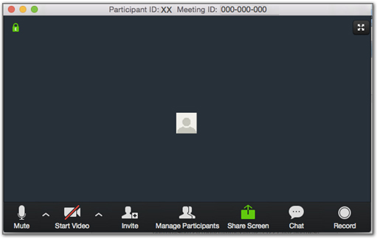
“…conferences…are critical. They are how we make new professional connections, and share ideas, and we come away with new energy and enthusiasm for our work.“ Sethuraman “Panch” Panchanathan, Director, National Science Foundation

