Slide 1
Cost Sharing Do’s and Don’ts
Tanya Dalton, Tara Gonzales & Kerwin Lawrence

Slide 2
Objectives
Gain an understanding of the different types of cost share
Learn when cost share should be included in a proposal
Learn the difference between cost share and leveraged resources
Become familiar with best practices for cost share documentation at the proposal and postaward stages

Slide 3
What is Cost Share?
Cost sharing or matching means the portion of project costs not paid by Federal funds (unless otherwise authorized by Federal statute) 2 CFR § 200.29
Expanded Definition
Cost Share occurs when a quantified portion of the costs of an award are not paid by the sponsor, but paid instead using resources within a department, school/college, or other party outside of the University.
It is a commitment to use resources other than the award itself for completion of the award objectives.
It is either required by the Sponsor or proposed (volunteered) by the Principal Investigator/Institution.

Slide 4
Types of Cost Share
Mandatory
Required by the sponsor for proposal
Voluntary Committed
Included in proposal when not required
Voluntary Uncommitted
Project Costs not included in the proposal

Slide 5
University Cost
Share
$25,000
UNIFORM GUIDANCE:
Cost sharing or matching is the portion of project costs not paid by Federal funds
25%
Total Project Cost
$100,000
100%
Federal (Sponsor) Obligation
$75,000
75%

Slide 6
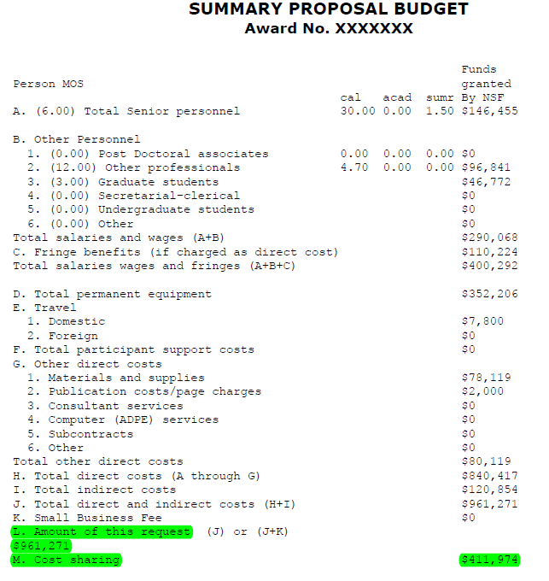
Example: Cost sharing 30% of total project cost
Award Amount: $961,271 70%
Cost Sharing: $411,974 30%
Total Project Cost: $1,373,245 100%
Excerpt from Program Solicitation:
Cost-sharing at the level of (precisely) 30% of the total project cost is required for Ph.D.-granting institutions and non-degree-granting organizations.

Slide 7
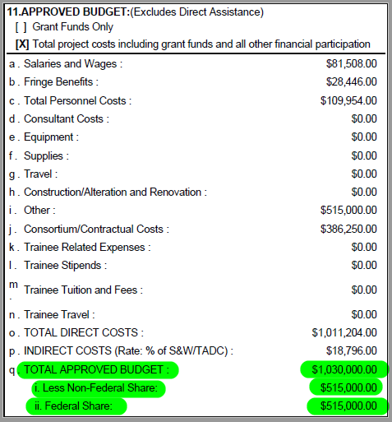
Example: 1:1 Match
Award Amount: $515,000 50%
Cost Sharing: $515,000 50%
Total Project Cost: $1,030,000 100%
Excerpt from Terms & Conditions (Award Notice):
Matching Requirements: An entity shall make available (directly or through contributions from state, county or municipal governments, or the private sector) recurring non‐federal contributions in cash or in kind, toward such costs. The matching ratio for AHEC awards is 1:1 (federal funds to non‐federal contributions). At least 25 percent of the total required non‐federal contributions shall be in cash.

Slide 8
Cost Share Sources
Direct Costs
-
Contributed Effort / Salary
Supplies, Equipment, Travel
Student Support / Tuition Waivers
F&A Costs
Unrecovered F&A on award costs when sponsor pays reduced F&A rate
F&A calculated on direct cost portion of CS
3rd Party
Project Costs paid for by an entity other than award sponsor or University

Slide 9
When should I include cost share in a proposal?

Slide 10
Minimize Cost Share when Possible
Only propose what is required – avoid voluntary cost share whenever possible.
Direct charge PI / Senior Personnel effort when sponsor allows.
Avoid specifically quantified amounts, such as effort percentages and dollars when the sponsor is not funding the cost.
However, when resources the University provides are PI or senior personnel time, we must quantify effort in order to track effort per OMB requirements.

Slide 11
Minimum Level of Effort Cost Share
Per OMB, the institution must track investigator effort.
The effort is part of the person’s base compensation and cannot be “volunteered.”
Therefore, the effort must be tracked, either as a direct charge to the grant, or as cost share.
Only on certain awards may faculty effort not be tracked, such as equipment or student support grants.

Slide 12
What about Leveraged Resources?

Slide 13
How are Project Cost Covered?
Grant funds from Federal Government
Cash and in-kind contributions from non-Federal sources
TOTAL PROJECT FUNDS

Slide 14
Leveraged Resources vs. Match/Cost Share
Leveraged resources can include cost share, but cost share does not include leveraged resources.
What are Leveraged Resources?
Funds used in coordination with the grant to support the grant’s outcomes
ETA* Definition:
All resources used by the recipient to support grant activity and outcomes, whether or not those resources meet the standards required for match/cost share.
Two Categories:
Allowable match
Non-match
Match/Cost Share
Additional non-Federal funds expended to support grant objectives when required either by statute or in the FOA as a condition of funding
Normally in the form of a direct cost that would otherwise be charged or utilized to support the grant or contract.
May take the form of Facilities & Administrative (F&A) Cost.
*ETA is the Employment and Training Administration, a division of Department of Labor

Slide 15
Non-Quantifiable Resources
Avoid quantifying resources available to the project when cost sharing is not required by the sponsor
Non – quantifiable language does not commit the University

Slide 16
Non – Quantifiable Language
Rephrase the Following to Ensure University is Not Committed to Cost Sharing:
The PI is requesting 10% salary support, and the University will provide an additional 5% salary support for the project.

Slide 17
Non – Quantifiable Language
Rephrase the Following to Ensure University is Not Committed to Cost Sharing:
The PI is requesting 10% salary support, and the University will provide an additional 5% salary support for the project.
The PI is requesting 10% salary support, and the University will provide additional support as needed.

Slide 18
Non – Quantifiable Language
Rephrase the Following to Ensure University is Not Committed to Cost Sharing:
A graduate research assistant will spend 4 hours per week analyzing samples for the project, but no salary is requested.

Slide 19
Non – Quantifiable Language
Rephrase the Following to Ensure University is Not Committed to Cost Sharing:
A graduate research assistant will spend 4 hours per week analyzing samples for the project, but no salary is requested.
A graduate research assistant will be assigned to analyze samples as necessary.

Slide 20
Non – Quantifiable Language
Rephrase the Following to Ensure University is Not Committed to Cost Sharing:
The PI will be able to access a mass spectrometer 8 hours per week for the project at no charge. The University will waive the normal fee of $100 per hour.

Slide 21
Non – Quantifiable Language
Rephrase the Following to Ensure University is Not Committed to Cost Sharing:
The PI will be able to access a mass spectrometer 8 hours per week for the project at no charge. The University will waive the normal fee of $100 per hour.
The PI will have access to resources such as a mass spectrometer to complete the project.

Slide 22
Administrative Burden & Best Practices

Slide 23
Compliance & Administrative Burden
When Cost Share is Committed:
Posting
Tracking
Monitoring
Reporting

Slide 24
Administrative Burden
Impact on F&A Recovery
Unable to recover F&A costs associated with cost sharing
Increased Department and Central Office Burden
Tracking and reporting on both sides
Increased Audit Risk
If cost share is not met or proven
Refund of award amount
Certification of effort

Slide 25
F&A Impact
F&A rate
F&A return to college and department
Recourses are re-directed from their intended primary use, to fund the cost share

Slide 26
How does cost share impact the negotiated F&A rate?
Cost Share Contributions (not including 3rd Party Cost Share) are factored into the Standard F&A Rate negotiations. The Standard F&A rate is calculated by taking the total direct costs from a selected period of time and dividing it by the total F&A costs for the same period. The ratio is the basis for the Standard F&A Rate. The Cost Share Commitments for that same period are added to the total direct costs, which decreases the Standard F&A Rate.

Slide 27
Potential Consequences of not meeting Cost Share Commitment
Sponsor may not accept invoice if cost share isn’t reflected on it.
Sponsor may consider the university in default of award if our cost share commitment isn’t met and could terminate the award.
If a third-party cost share commitment isn’t provided, the university’s cost share commitment could increase accordingly.
Sponsor may disallow a prorated portion of the university’s allowable expenses if cost share commitment is not met.
Future funding for Sponsor could be put at risk.
The university is ultimately responsible for meeting the cost share requirements. If you think you won’t meet your commitment, contact your central office immediately.

Slide 28
Roles and Responsibilities

Slide 29
Roles and Responsibilities
Proposal Review
Review Mandatory Cost Share Requirements
Review Cost Share Budgets
Review PI Effort
Post Award Compliance
Create cost share accounts
Update cost share requirements within financial system
Ensure committed cost share is met
Maintain documentation for cost share
Report cost share if required

Slide 30
Post Award Monitoring
Review CS Requirements
Notice of Award
Proposal Budget
Post Cost Share
Payroll distributions
Correctly coding financial transactions
Process cost transfers to post CS not correctly coded at time of transaction
Monitor commitment to ensure CS requirements are on track when reconciling accounts
Monitor 3rd party
Maintain documentation for audit purposes
*Post Award Monitoring is a responsibility shared between central administration and the campus unit.

Slide 31
Cost Sharing Recap
What Costs Are Allowable?
What Costs Are NOT Allowable?
Reasonable & Allocable
Necessary for performance of award
Treated consistently across funding sources
Per award terms and conditions
Per institutional policies and procedures
Amounts used as cost sharing on another project
Other federal award expenditures unless allowed by statute
Other non-federal sponsors expenditures unless approved by that agency
Administrative and clerical costs, unless allowed as direct costs on sponsor share

Slide 32
Questions?

