Slide 1
UAHS Research Administration Organizational Structure and Training Program
Sarah Clarke
Assistant Manager, UAHS Research Administration, Grants

Slide 2
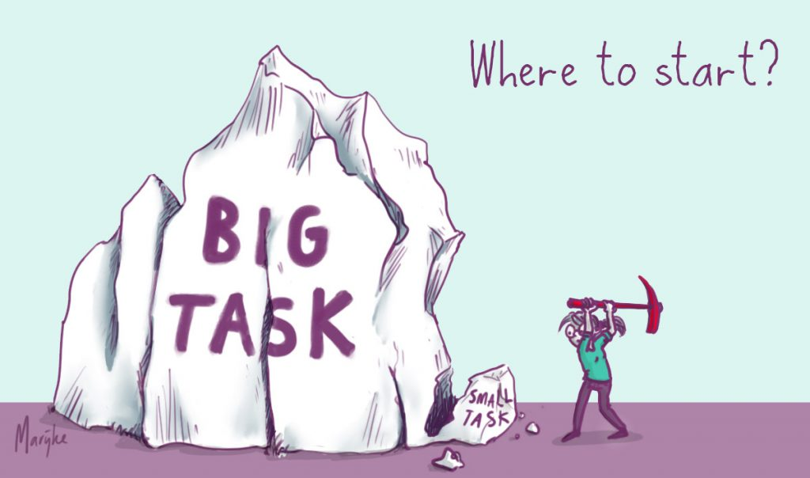

Slide 3
UAHS Research Administration: What do we do?
Grants – Focus of this presentation
Contracts
Clinical Trials
Regulatory

Slide 4
UAHS RA – Grants: Who do we support?
College of Medicine – Tucson
College of Medicine – Phoenix
College of Public Health
College of Pharmacy
College of Nursing
Centers and Institutes →

Slide 5
UAHS RA – Grants: Who are we?
One Director
Two Assistant Managers
Two Senior Research Administrators
Seven Research Administrators
Seven Coordinators
19 People!!

Slide 6
UAHS RA – Grants: How do we provide support?

Slide 7
UAHS RA – Grants: How do we distribute the labor?

Slide 8
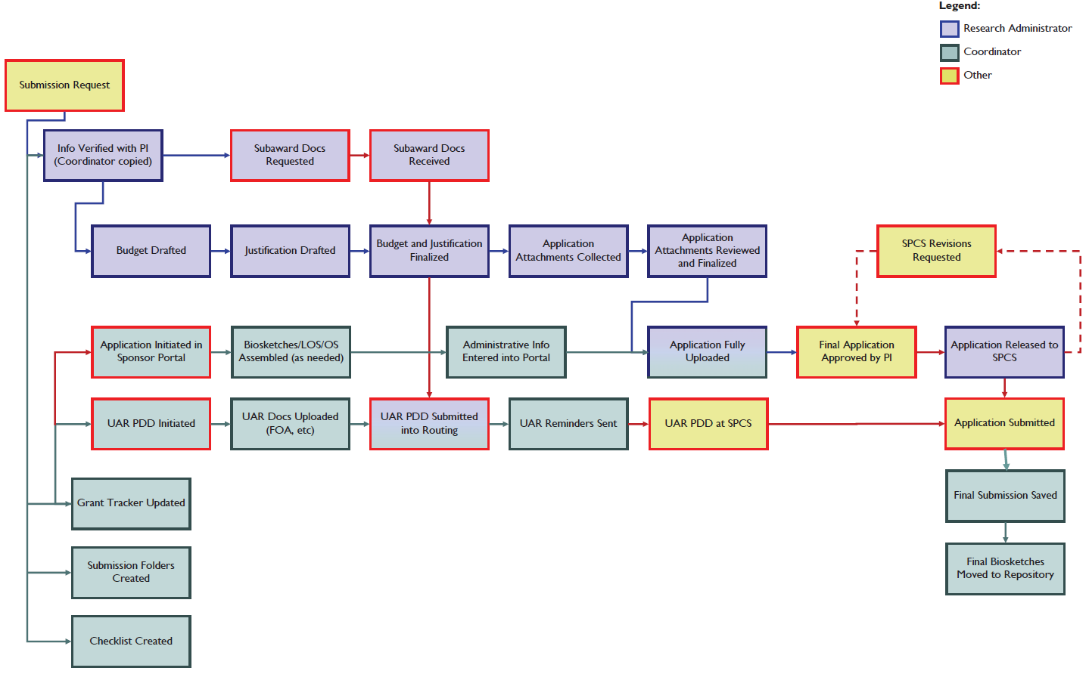

Slide 9
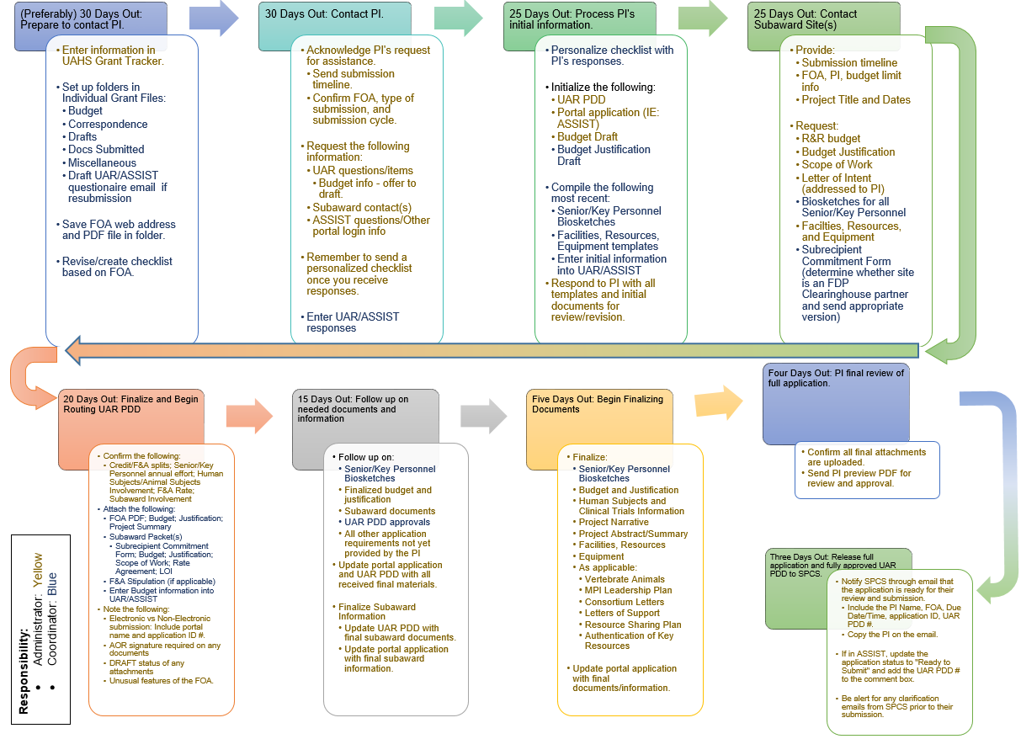

Slide 10
How did we build it?

Slide 11
UAHS RA – Grants: How did we build our team?
Hire entry-level coordinators for the established team atmosphere and/or needs.
Train them up with established timelines and milestones.
Provide individual, paired, and team-level professional development and relationship coaching.

Slide 12
UAHS RA – Grants: Hiring Strategy
Four person application review
Phone Interviews
Interview with Senior RAs
Interview with Asst. Managers and Director
Interview with Coordinators

Slide 13
UAHS RA – Grants: Training GANTT Chart

Slide 14
UAHS RA – Grants: Training Rubrics

Slide 15
UAHS RA – Grants: Coaching
Weekly
Director/RA One-on-Ones
Asst Mngr/CO One-on-Ones
Director/Asst Mngr One-on-Ones
Full Team Meetings
CO Team Meetings/Training
Focus on
Process and Communication Refinement
Professional SMART Goals
Milestone Accomplishments

Slide 16
UAHS RA – Grants: Transition to RA
Director, Asst Mngr, and CO buy-in
RA Readiness Self-Assessment
Targeted Development for any low ratings

Slide 17
UAHS RA – Grants: Staged Transition from CO to RA
In addition to CO duties: One Modular Submission with RA Review
In addition to CO duties: Few Varied Submissions with RA Review
In addition to CO duties: Various Independent Submissions
In addition to CO duties: One Unit Support
Promotion and Additional Unit Assignment

Slide 18
UAHS RA – Grants: RA Progression
Transitioning CO’s target is Novice.
Transitioning RA to Senior RA’s target is Mentor.

Slide 19
Questions!

