Slide 1
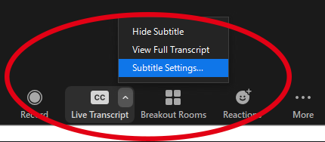
Welcome to the Tri-University Research Administration Conference.
Your session will begin shortly. While you wait, please review the following reminders::
Zoom Troubleshooting
Issues with Audio
Turn off headset/computer speakers and call in by phone for audio
General Issues
Log off and log back in using SSO
Technical Support
Call 480-965-9065 Ext 1.
About this Session
Recording
Today’s session is being recorded and will be made available for later viewing
Closed Captioning
The Closed Caption/Live Transcript feature has been enabled. You can show/hide the CC via your meetings controls located at the bottom of your screen.
We’d Love Your Feedback!
To help us plan next year’s Tri-University Research Administration Conference, we would love to get your feedback.
If you want to provide feedback for the presenters of today’s session, make sure to complete the survey you will receive via email at the end of the day.

Slide 2
Current & Pending, Other Support, Foreign Influence, and Report
Ekaterina Khaustova, Lael Thompson, and Yang Wen

Slide 3
NSF Current and Pending Support, NIH Other Support, An Overview Presenter: Yang Wen RAA, CIDSE

Slide 4
Current and Pending Support
Information must be provided about all current and pending support, including this project, for ongoing projects, and for any proposals currently under consideration from whatever source, irrespective of whether such support is provided through the proposing organization or is provided directly to the individual.
Current and pending support also includes in-kind contributions such as office/laboratory space, equipment, supplies, employees, students. In-kind contributions not intended for use on the project/proposal being proposed also must be reported.
Other Support
Information on other active and pending support may be requested (often as part of Just-in-Time procedures for grant applications or in progress reports) to ensure there is no scientific, budgetary, or commitment overlap.
Other Support includes all financial resources, whether Federal, non-Federal, commercial or institutional, available in direct support of an individual's research endeavors, including but not limited to research grants, cooperative agreements, contracts, and/or institutional awards. Training awards, prizes, or gifts do not need to be included.

Slide 5
NSF Current and Pending Support
Fillable Template

Slide 6
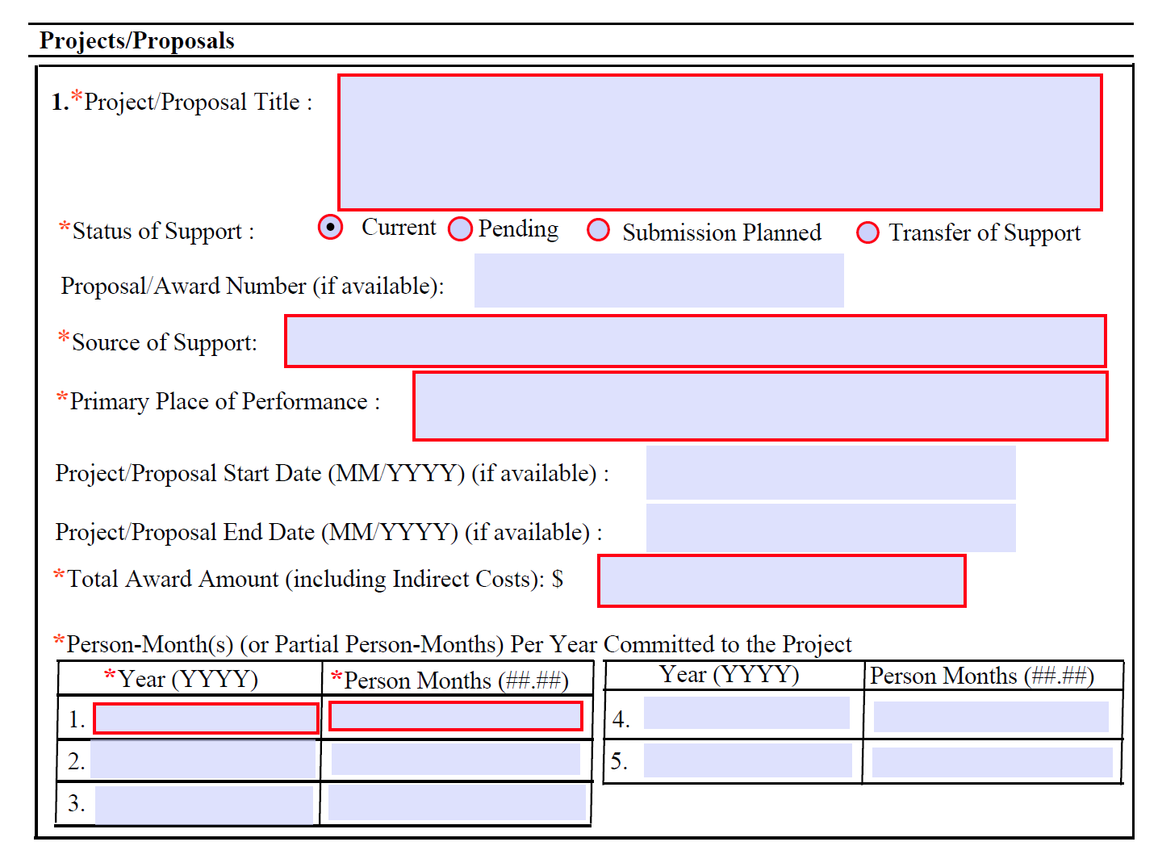
NSF Current and Pending Support
Fillable Template

Slide 7
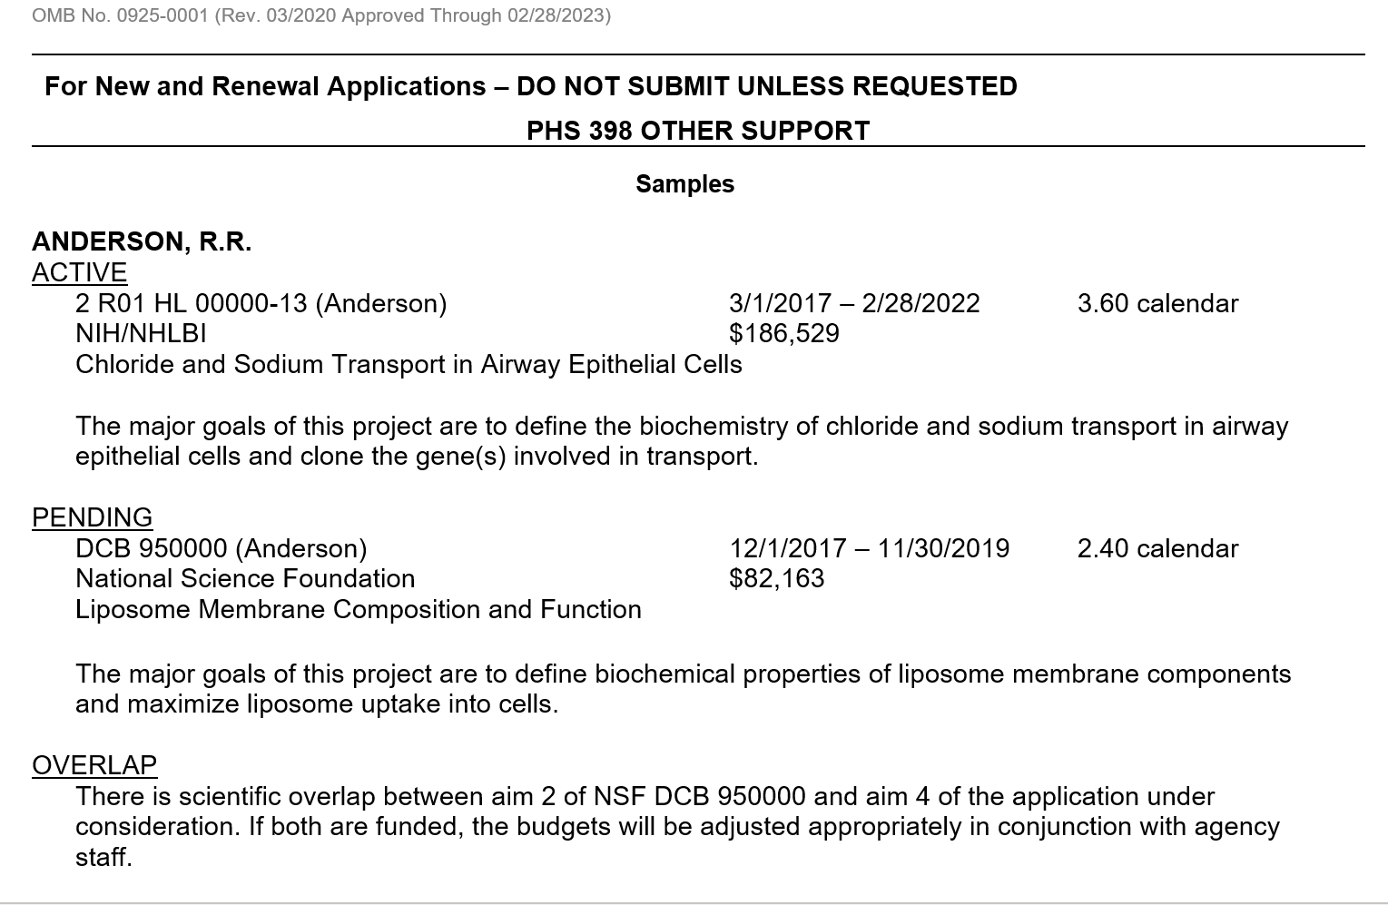
NIH
Other Support
Samples

Slide 8
What to report?
All resources made available to the individual in support of and/or related to all of his/her research efforts, regardless of whether or not they have monetary value, need to be reported.
If the project (or any part of the project) now being submitted has been funded previously by a source other than NSF, information needs to be provided regarding the last period of funding.
Information on the proposal being submitted should be included.
Other resource should include all financial resources, whether Federal, non-Federal, commercial or institutional, available in direct support of an individual's research endeavors, including but not limited to research grants, cooperative agreements, contracts, and/or institutional awards.
Other Support doesn't include the proposal being submitted.

Slide 9
When to report?
At the proposal submission stage
As part of Just-in-Time procedures for grant applications
In the progress reports

Slide 10
Who should report?
Each individual designated as senior personnel on the proposal (PI, Co-PI, Senior Personnel).
All individuals designated in an application as senior/key personnel, except
Program Directors, training faculty, and other individuals involved in the oversight of training grants
Individuals categorized as Other Significant Contributors
All senior/key personnel, excluding consultants, in progress reports when there has been a change in active other support, except
Program Directors, training faculty, and other individuals involved in the oversight of training grants

Slide 11
Key Information?
Project title
Status of support
Source of support
Primary place of performance
Project start date
Project end date
Total award amount
Person months
Project number
Contact Principal Investigator
Status of support
Source of support
Title of project/subproject
Dates of approved/proposed project
Person months
Major goal

Slide 12
Who are reviewing and what are they reviewing?
Grant management
Panel reviewers
IC scientific program and grants management staff will review this information before award to ensure the following:
- Sufficient levels of effort are committed to the project.
- There is no scientific, budgetary, or commitment overlap.
- Only funds necessary to the approved project are included in the award.

Slide 13
Format/Template
NSF Fillable PDF
SciENcv (NCBI)
NIH Other Report Form page

Slide 14
Questions?

Slide 15
Presenter: Ekaterina Khaustova Research Advancement Administrator, Arizona State University

Slide 16
Effective October 2020, NSF only accept Current and Pending Support PDFs that are generated through the use of an NSF-approved format, such as the NCBI SciENcv website.
NCBI SciENcv website
More than 15 current and pending projects
Fillable PDF
Less than 15 current and pending projects

Slide 17
SciENcv Background: Science Experts Network Curriculum Vitae (SciENcv) is an electronic system that helps researchers assemble the professional information needed for participation in federally funded research. SciENcv gathers and compiles information on expertise, employment, education and professional accomplishments. Researchers can use SciENcv to create and maintain biosketches and Current and Pending Support that are submitted with grant applications and annual reports. SciENcv allows researchers to describe and highlight their scientific contributions in their own words.
What SciENcv does:
Eliminates the need to repeatedly enter biosketch information and CP’s
Reduces the administrative burden associated with federal grant submission and reporting requirements
Provides access to a researcher-claimed data repository with information on expertise, employment, education, and professional accomplishments
Allow researchers to describe their scientific contributions in their own language

Slide 18
Step 1: Login to SciENcv with your NSF Credentials
How to set up and work with NCBI account.
Step 2: Proceed with creating your NCBI account with any email you choose.

Slide 19
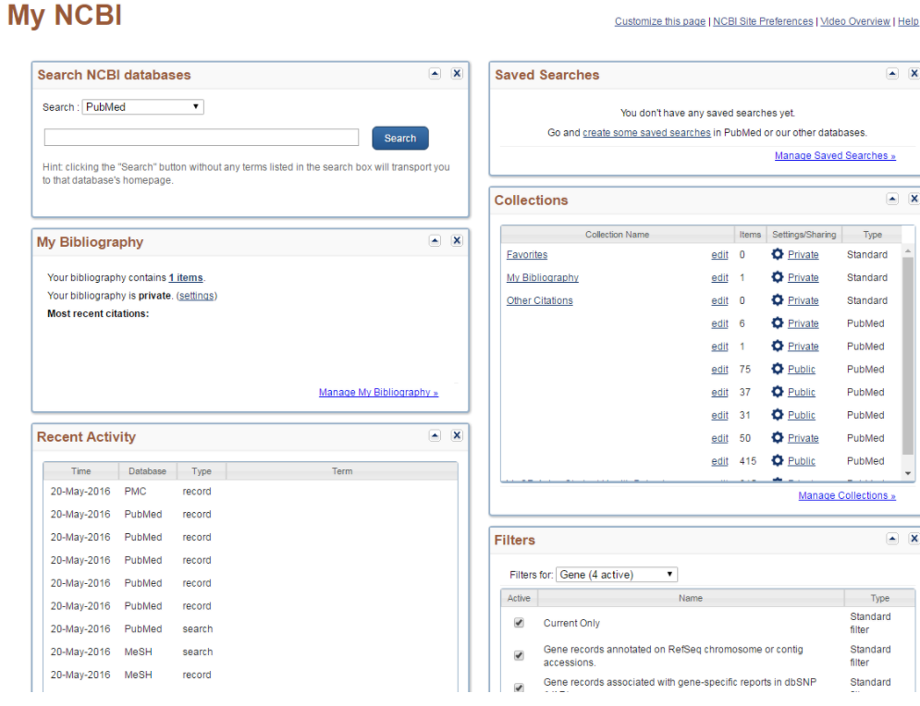
Step 3: Once you are registered, you will be directed to your personal NCBI account landing page (also called My NCBI).
How to set up and work with NCBI account.

Slide 20
Any My NCBI account holder can set up one or more delegates for their My NCBI account. Once a delegate has accepted their invitation, the delegate(s) has the ability to view, edit, and create profiles in the original account holder’s SciENcv, as well as edit the account holder’s My Bibliography information.
Delegation process
PI steps
To sent a Delegate request
Log in to your My NCBI account
Select your username in the top-right corner of the screen to access the Account Settings page
Under “Delegates,” select “Add a delegate”
Enter your delegate’s email address and select "OK"
RA steps
To accept a Delegate request
Log in to your My NCBI account
Check your email for the delegate request. If you haven’t received the request email, be sure to check you spam folder – the email comes from myncbi@ncbi.nlm.nih.gov
Use the link in the delegate request email to accept and confirm the delegation

Slide 21
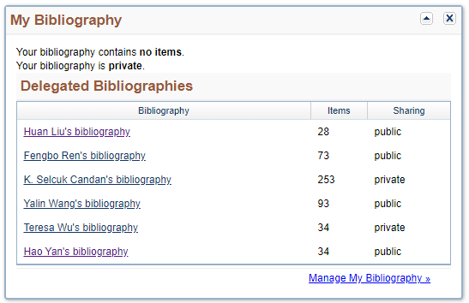
Delegation process
To access your Delegator’s SciENcv
If you have been granted access to your delegator’s My Bibliography and Other Citations collections, you will see those items listed in your collections list:
If you have been granted access to your delegator’s SciENcv, you will be able to access it from your SciENcv portlet:

Slide 22
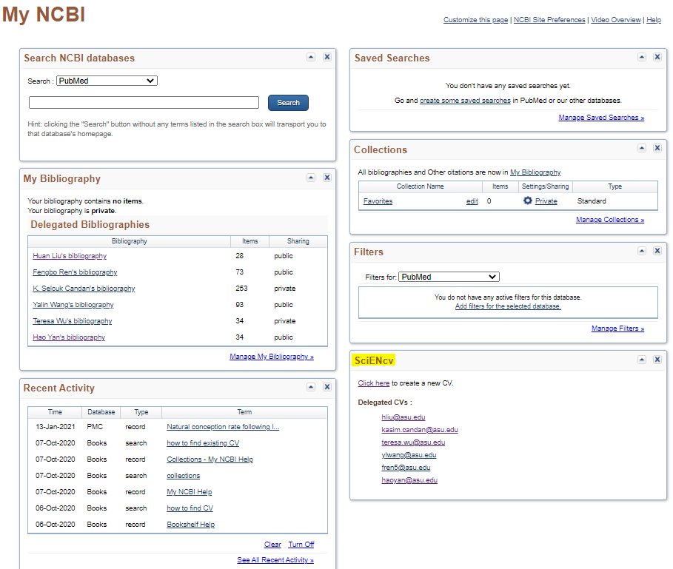
Working with NCBI generated Current and Pending Form
To access your PI’s Current and Pending Support:
Log in to your My NCBI account
Choose the PI from your SciENcv portlet.

Slide 23
Working with NCBI generated Current and Pending Form

Slide 24
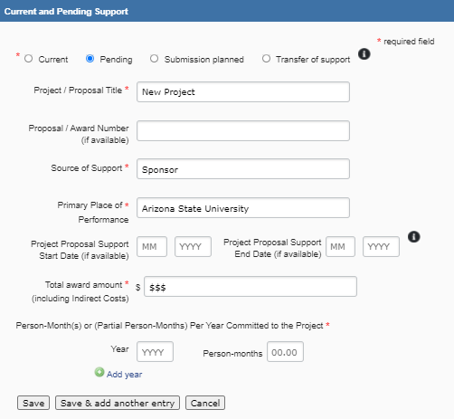
Working with NCBI generated Current and Pending Form

Slide 25
To Recap: NSF-Approved Formats for Current and Pending Support
NCBI website
Create NCBI account
Accept Delegate’s request
Create/edit CP’s
Download & use
Fillable PDF
https://www.nsf.gov/bfa/dias/policy/cps.jsp

Slide 26
Questions.

Slide 27
Presenter: Lael Thompson Compliance Coordinator, Sr. Arizona State University

Slide 28
Importance of International Collaboration
U.S. scientists routinely collaborate productively with investigators in foreign countries … We must rely on productive research collaborations with foreign entities.
Individuals violating laws/policies represent a small proportion of scientists working in and with U.S. institutions. We must not reject brilliant minds working honestly and collaboratively to provide hope and healing.
Enables cutting-edge research that no nation can achieve alone
Strengthens scientific and diplomatic relations
Leverages resources including funding, expertise and facilities
Trains a robust Science and Technology workforce capable of solving global challenges
International students and scholars contribute significantly to the U.S. research enterprise

Slide 29
Key Concerns
Failure to disclose substantial foreign resources
– Foreign employment arrangements
– Foreign grant support: overlap, duplication, over-commitment
– In many cases, American institutions unaware
Non-disclosure of substantial foreign research support (free research labor e.g., visiting scholar/students funded by a foreign source); talents awards
Unauthorized transfers of information and data
Failure to disclose significant foreign financial conflict of interest (FCOI), such as equity in foreign companies and patents
Peer review violations
Shadow laboratories or other parallel research activities

Slide 30
What are the Risks?
Risks to the Integrity of the Research Enterprise
Violations of responsible and ethical conduct of research
Actions that undermine peer review and grant award processes
Risks to National Security
Hidden diversions of research and/or resources that threaten U.S. leadership in emerging science and technology
Risks to Economic Security
Hidden diversions of research and/or resources that weaken the innovation base and threaten economic competitiveness
Individual Risks
Current and future relationships with Sponsors
Law enforcement concerns
Intellectual Property

Slide 32
What does the Sponsor Require?

Slide 33
National Institutes of Health
NIH policy requires all individuals included in an application as senior/key personnel – including the program director/principal investigator (PD/PI) and for other individuals who contribute to the scientific development or execution of a project in a substantive, measurable way to disclose “all resources made available to a researcher in support of and/or related to all of their research endeavors, regardless of whether or not they have monetary value and regardless of whether they are based at the institution the researcher identifies for the current grant,” and for determination to be made if the project activities include a foreign component, “significant scientific element or segment of a project to be performed outside the United States.”
Foreign engagement and other support should be disclosed in proposals, and in interim and final Research Performance Progress Reports (RPPR). Specific disclosure of "Foreign Components" is to be disclosed on its Research and Related Other Project Information Form submitted with proposals. This disclosure is in Item 6 of the Research & Related Other Project Information Form.
Throughout a project if the need arises to include a foreign component, it requires NIH prior approval and should always be included in the foreign components section of the RPPR Report, Section G.9.

Slide 34
National Science Foundation
NSF policy requires full disclosure of domestic and foreign engagements, regardless if funded or unfunded. Disclosures are to occur in Current and Pending Support; Annual reports; final reports and Biosketches.
Biosketches – domestic and foreign appointments, funded and unfunded (e.g. Scientific Advisor, Consultant, etc.) are to be included in the “Appointment Section.” In addition, submission of an update can occur by your Sponsored Research Officer (SRO) through the "Other request" category in the Notification and Request Module in Research.gov

Slide 35
U.S. Department of Energy
DOE policy requires full disclosure, domestic and foreign engagements/support, regardless if funded or unfunded. Disclosures are to occur in Current and Pending Support as announced in DOE FY 2020 Continuation of Solicitation for the Office of Science Financial Assistance Program. Include as an appendix to the project narrative. DO NOT attach a separate file.

Slide 36
National Aeronautics and Space Agency
NASA requires full disclosure, domestic and foreign engagements/support, regardless if funded or unfunded. Disclosures are to occur in Current and Pending Support as outlined in NASA Guidebook for Proposers Responding to a NASA Funding Announcement.
If a co-I is spending more than 10% of his/her time on an active award or pending proposal, regardless if funded or unfunded, it needs to be disclosed on the Current and Pending Support.
A proposal being submitted does not need to be included on the Current and Pending Support, unless the same proposal has been submitted to another agency.
If an Investigator has a NASA contract, terms and conditions should be reviewed as it may have additional requirements.

Slide 37
U.S. Department of Defense
DOD policy requires full disclosure for all key personnel, in addition to PI or Co-PI, even if efforts are or are not to be funded by DOD., domestic and foreign engagements/support, regardless if funded or unfunded. Disclosures are to occur in Current and Pending Support as announced in March 20, 2019 memo. This memo applies to new research activities after April 19, 2019 and applies to grants, cooperative agreements, etc.
If an Investigator has a DOD contract, terms and conditions should be reviewed as it may have additional requirements.

Slide 38
Best Practices for Foreign Relationships and Activities
Check with your Research Administration Office
Fully and accurately disclose domestic and foreign engagements, including equity interests in foreign entities
Obtain restricted party screening of foreign collaborators, including foreign visitors
Include a clear description of all foreign collaborations when developing proposals
Review Investigator’s active awards and pending proposals to ensure all locations outside of the United States have been disclosed to the federal agencies and the Institution
Ensure that any material transfers, data sharing and confidential information are covered by an agreement
Be aware of and follow peer review regulations, including confidentiality provisions related to the content provided during the review
Obtain export control review for incoming and outgoing collaborations, including traveling abroad and international rework requests – whether funded or unfunded

Slide 39
Questions?

Slide 40
Presentation Resources
ACD Working Group on Foreign Influences on Research Integrity Update (June 12, 2020)
Michael S. Lauer MD, Deputy Director for Extramural Research, NIH
Foreign Influence and its Impact on Research Integrity – A Four-Part Series | Part 1: What is Foreign Influence?
Gloria Greene
RCR Foreign Influence in Research Workshop
Debra Murphy and Heather Clark
https://researchadmin.asu.edu/international-engagement

