Slide 1
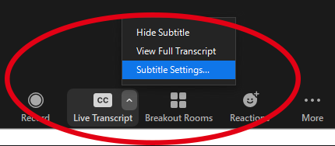
Welcome to the Tri-University Research Administration Conference.
Your session will begin shortly. While you wait, please review the following reminders::
Zoom Troubleshooting
Issues with Audio
Turn off headset/computer speakers and call in by phone for audio
General Issues
Log off and log back in using SSO
Technical Support
Call 480-965-9065 Ext 1.
About this Session
Recording
Today’s session is being recorded and will be made available for later viewing
Closed Captioning
The Closed Caption/Live Transcript feature has been enabled. You can show/hide the CC via your meetings controls located at the bottom of your screen.
We’d Love Your Feedback!
To help us plan next year’s Tri-University Research Administration Conference, we would love to get your feedback.
If you want to provide feedback for the presenters of today’s session, make sure to complete the survey you will receive via email at the end of the day.

Slide 2
Research Project Performance Reports (RPPRs)
Sarah Clarke, Office of the Senior Vice President for Health Sciences, University of Arizona

Slide 3
Ready…
The RPPR is used by grantees to submit progress reports to NIH on their grant awards.
https://grants.nih.gov/grants/rppr/index.htm

Slide 4
Get set…
Original Funding Opportunity Announcement (FOA)
Reporting Requirements
Most recent Notice of Award (NOA)
Named Senior/Key Personnel
SNAP participation
Special Reporting Requirements
Supplements
Most recent RPPR or funded application (if requesting Year 2 funding)
Senior/Key Personnel and Effort Committed
Human Subjects/Vertebrate Animals Involvement
Performance Sites/Foreign Involvement
Anticipated Budget
Specific Aims

Slide 5
Go!
Section A: Cover Page
Project Title: Ensure congruency among the RPPR, the NOA, and the institutional record.
Administrative and Signing Officials: Ensure they are correct for your institution.
Reporting Period: Ensure the data your investigators are providing are for this period only!
NCEs – All but the personnel table (Section D) should reflect the full period.
Section B: Accomplishments
B.1: Goals
When requesting Year 2, pull AIMS from funded application.
B.3: Supplements
Must complete all fields to save.
If diversity supplement, the individual should also be included in the personnel table (Section D).
B.4: Training
Required if listing any of the following in the personnel table (Section D):
Undergraduates
Graduate students
Post-doctoral students

Slide 6
Still going…
Section C: Products
C.1: Publications
Must be Reported if:
Directly resulting from the funds provided in this award
Accepted for publication during the reporting period
Must be compliant with the NIH Public Access Policy
May take up to eight weeks
Must be linked to the RPPR through the PI’s MyNHLBI bibliography
Section D.1: Participants Table
Individuals must be reported ONLY if at least one complete person month of effort was provided.
Effort listed in whole months
Funding source of effort is irrelevant
eRA Commons accounts are required for all students
Undergraduates
Graduate Students
Post-doctoral Researchers

Slide 7
Keep going…
Section D.2: Participants Con’t
Change in S/K Personnel Effort
Only applies to S/K P listed on the NOA
Only applies if effort is decreasing more than 25% of the originally listed effort
Changes in Other Support
Applies to all PI-designated S/K P
Only applies to support awarded or closed out during the reporting period
Excludes pending
Must note application under review
Section F: Changes
F.2: Actual or anticipated delays
Reserved for significant challenges that affect the accomplishment of the project’s Aims.
Consider including if carryforward balance (Section G.10) is greater than 25%.

Slide 8
It’s a long way…
Section G: Special Reporting Requirements
Re-check NOA and FOA.
For diversity supplements, some I/Cs require a CareerTrac Report

Slide 9
Section G: Special Reporting Requirements HUMAN SUBJECTS
Reporting now housed in ASSIST!
If requesting Year 3 or later, the ASSIST Post-Submission HSCT form will need to be updated to “Work in Progress” to edit.
Clinical Trials Are Special
RPPRs now include an additional % enrollment timeline that must be completed.
Errors/Warnings are Persistent
Will not clear in eRA Commons until the HSCT post-submission form is submitted in ASSIST.

Slide 10
Section G: ESTIMATED UNOBLIGATED BALANCE
To Calculate:
If requesting Years 3+:
Add carryforward amount from previous year to the awarded amount for the reporting period.
Add estimated final expenses to the actual expenses of the reporting period.
Divide the first by the last.
If requesting Year 2, disregard the carryforward inclusion.
Err on conservative side!

Slide 11
Section G: Estimated Unobligated Balance When the answer is YES
G.10.b: Explanation for UOB
Examples:
Year 1 awarded full budget, but budget period was less than 12 months.
Delay in hiring staff hindered scientific progress, so expenses were less than expected.
Departure of staff
Approved equipment not purchased when expected due to vendor delays
G.10.c: Description of how the Carryforward funds will be spent
Provide direct/indirect cost breakdown.
Provide general explanation of how the funds will be spent (must not duplicate originally predicted spending)
When the NOA required approval for carryforward, the annual financial report will be submitted following the end of the reporting period and a formal prior approval request must be submitted.

Slide 12
Almost there…
Section H: Budget
Only required of non-SNAP awards.
Always due on the 1st of the month
Match total costs to the projected total costs for that year on the NOA.

Slide 13
Finished!

Slide 14
Prior Approval Requests for NIH Awards
Tara Jenkins & Mirna Hodzic Mun, Office for Research & Sponsored Projects Administration,
Arizona State University

Slide 15
Outline
Resources
Common Post-Award Change Requests
First No-Cost Extensions
Subsequent No-Cost Extensions
Carryover Requests
Change of PD/PI Requests
Preparing & Submitting Prior Approval Requests

Slide 16
Resources
Terms/Conditions and Policies
Original notice of award (NOA)*
Latest NOA
Funding Opportunity Announcement (FOA)
NIH Grants Policy Statement
Prior Approval Matrix
Notice # NOT-OD-06-054
*For specific requirements, contact assigned Grants Management Specialist (GMS) listed in NOA.
Process & Training
NIH Guidance on Seeking Prior Approval
NIH Guidance on Submitting NCEs
eRA Commons User Guide
eRA Commons Tutorials
eRA Commons Additional Training
Handout #1 – Common post-award change types
Handout #2 – No-cost extension justification examples

Slide 17
Common Post-Award Change Requests
Grantee-authorized/Sponsor Approval Waived | Sponsor Approval Required
One-time no-cost extension (NCE) without additional funds for up to 12 months for a final budget period¹ | Additional NCEs, extension longer than 12 months, late submission of initial NCE, or NCEs for awards without expanded authority/with restrictions
Rebudgeting participant support funds into other categories² | Change in scope
Rebudgeting among other direct cost categories and between direct and indirect cost categories² | Change in Principal Investigator (PI)/Program Director (PD) or other senior/key personnel and their status
Establishing new subaward³ | Transferring award to another institution
Incurring pre-award costs < 90 days before start date of new or competing continuation/renewal award⁴ | Incurring pre-award costs > 90 days
Carryover of unobligated balance⁵
Incurring capital expenditures⁶
¹Unless award is not under expanded authority or NOA/FOA otherwise prohibits.
²Unless change in scope or NOA/FOA otherwise prohibits.
³Unless change in scope, subrecipient is foreign​​ or NOA/FOA otherwise prohibits.
⁴Certain restrictions apply to training grants or fellowships. See Grants Policy Statement.
⁵Unless terms of NOA/FOA prohibit. Automatic carryover does not apply to certain awards. See Handout #1.
⁶Waived for general purpose equipment only and if no change in scope and NOA/FOA otherwise does not prohibit.

Slide 18
First No-Cost Extensions (NCEs)
An extension of a budget period/project period to complete the original scope of work without additional funds, for awards for which the closeout process has not begun.
Under expanded authority, grantee-authorized*:
One-time extension, maximum of 12 months
Available within 90 days before current project end date**
Incomplete scope of work & funds available
*Awards without expanded authority/with restrictions → sponsor approval is required.
**Late requests require prior approval.

Slide 19
Subsequent No-Cost Extensions (NCEs)
Subsequent NCEs
NCEs greater than 12 months
Late initial NCEs
Restricted NCEs*
*Award is not under expanded authority or NOA/FOA otherwise prohibits grantee-authorized NCEs.
Prior approval is required!

Slide 20
Preparing & Submitting NCE Requests
Secure PI/MPI Approval, Justification & Needed Documentation
Submit via eRA Commons
Receive Notification Confirming, or Obtain Revised NOA for, Authorized Extension

Slide 21
Preparing & Submitting NCE Requests
Grantee-authorized Initial NCEs
Sponsored-approved NCEs
PI/MPI approval
Internal Justification: remaining project activities from original scope of work, explanation of delay in project completion, & unobligated balance available/plan for use of unspent funds.
Signing Official (SO) submits notification in eRA Commons via Status module, within 90 days before current project end date.
E-mail notification sent to NIH, SO and PI → new end date automatically authorized.
PI/MPI approval
SO confirms required documentation with awarding Institute/Center (IC) → progress report, budget, and justification. Need unobligated balance, confirmation of PI's "measurable" effort, and protocol approval date (e.g., IRB, IACUC).
SO submits request via Prior Approval Module, within 90 days of current project end date or before closeout (within 270 days after project end date, or unilateral closeout).
E-mail notification sent to NIH, SO and PI → if approved, revised NOA issued.

Slide 22
Submission Process – NCEs in Status Module

Slide 23
Submission Process – NCEs in Status Module

Slide 24
Submission Process – NCEs in Status Module

Slide 25
Submission Process – NCEs in Status Module

Slide 26
Submission Process – NCEs in Status Module

Slide 27
Submission Process – NCEs in Status Module

Slide 28
Submission Process – NCEs in Prior Approval Module

Slide 29
Submission Process – NCEs in Prior Approval Module

Slide 30
Submission Process – NCEs in Prior Approval Module

Slide 31
Submission Process – NCEs in Prior Approval Module

Slide 32
Submission Process – NCEs in Prior Approval Module

Slide 33
Submission Process – NCEs in Prior Approval Module

Slide 34
Submission Process – NCEs in Prior Approval Module

Slide 35
Carryover of an Unobligated Balance
Carryover is when unobligated funds remain at the end of any budget period that the grantee would like to use in the next budget period. These funds may be used to cover allowable costs of the next budget period (whether as an offset or additional authorization). Obligated, but unliquidated, funds are not considered carryover.
Under expanded authority, grantee-authorized*:
Carry over unobligated funds into the next budget period without prior approval.
Carry over unobligated funds from one competitive segment to another without prior approval.
Awards without expanded authority → sponsor approval is required:
Centers (P50, P60, P30, other), cooperative agreements (U), Kirschstein-NRSA institutional research training grants (T), non-Fast Track Phase I SBIR and STTR awards (R43 and R41), clinical trials (regardless of activity code), awards to individuals, and any award with a restricting special term or condition in the NoA.
Reminder: At the end of five years, unused funds are cancelled and returned to the US Treasury. This may limit the availability of funds for carryover.
*If unobligated balance is greater than 25% of total approved budget, recipient must provide explanation, and indicate plans for expenditure within the current budget year to GMS. For awards that require annual FFRs, regardless of percentage, amount to be carried over must be specified under item 12, "Remarks.”
Notes:
Explain difference between unobligated and unliquidated. “Unliquidated obligations are commitments of the recipient, and are considered to be obligations and, therefore, should not be reported as unobligated balances.”

Slide 36
Preparing & Submitting Carryover Requests
Secure PI/MPI Approval & Needed Documentation
Submit via eRA Commons
Receive Notification Confirming, or Obtain Revised NOA for, Authorized Carryover

Slide 37
Preparing & Submitting Carryover Requests
Grantee-authorized
Sponsor-approved
No Action*
*For awards that require annual FFRs, regardless of percentage, the amount to be carried over must be specified under item 12, "Remarks”. If unobligated balance is greater than 25% of total approved budget, provide an explanation and indicate plans for expenditure of those funds within the current budget year to GMS.
PI/MPI approval
SO confirms required documentation with awarding Institute/Center (IC) → unobligated balance, detailed budget, scientific justification, explanation for carryover, any other documents requested.
SO submits request via Prior Approval Module.
E-mail notification sent to NIH, SO and PI → if approved, revised NOA issued.

Slide 38
Submission Process – Carryover Request in Prior Approval Module

Slide 39
Submission Process – Carryover Request in Prior Approval Module

Slide 40
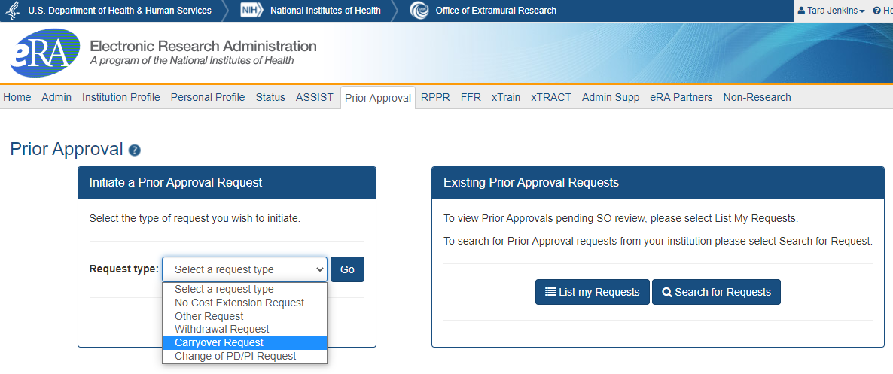
Submission Process – Carryover Request in Prior Approval Module

Slide 41
Submission Process – Carryover Request in Prior Approval Module

Slide 42
Submission Process – Carryover Request in Prior Approval Module

Slide 43
Change of PD/PI
When it is necessary to change (remove or add) a program director/principal investigator (PD/PI) on a grant, due to a number of scenarios.
Always requires prior approval from NIH.
Submit requests electronically using the Prior Approval > Change of PD/PI feature in eRA Commons.
Only the signing official (SO) can initiate and submit the Change of PD/PI request.
Requests can only be made for a grant year that is currently awarded, and within the budget period.

Slide 44
Preparing & Submitting PI Change Requests
Secure PI/MPI Approval & Needed Documentation
Submit via eRA Commons
Receive Notification Confirming or Obtain Revised NOA

Slide 45
Preparing & Submitting PI Change Requests
Grantee-authorized
Sponsor-approved
Not applicable - always requires sponsor approval
PI/MPI approval
SO confirms required documentation with awarding Institute/Center (IC) → Names to be removed/added, Level of Effort, Effective Date, Justification, Biosketch, any other documents requested.
SO submits request via Prior Approval Module.
E-mail notification sent to NIH, SO and PI → if approved, revised NOA issued.

Slide 46
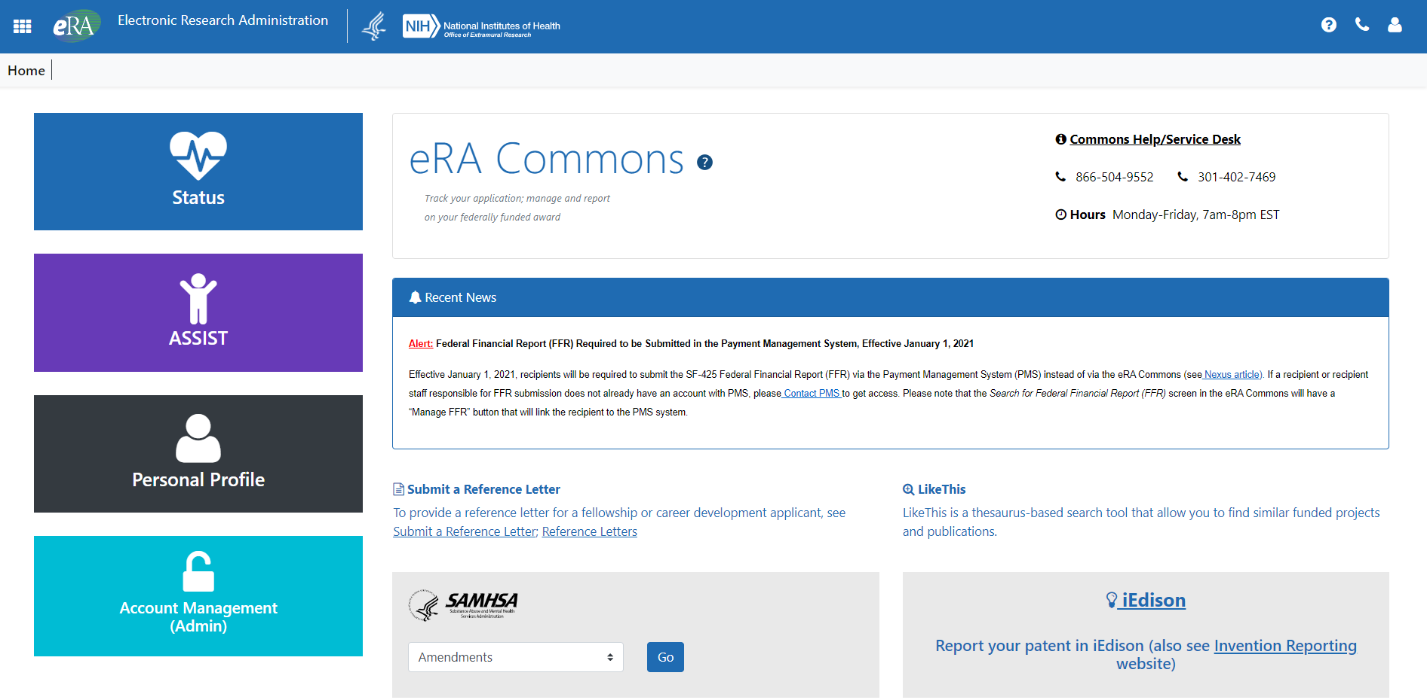
Submission Process – PI Change in Prior Approval Module

Slide 47
Submission Process – PI Change in Prior Approval Module

Slide 48
Submission Process – PI Change in Prior Approval Module

Slide 49
Submission Process – PI Change in Prior Approval Module

Slide 50
Questions?

